Slide 1

Divvy Bikes Chicago
Team 11
Tanvi Dalvi
Vedanti Gulalkari
Xindi Liu

Slide 2
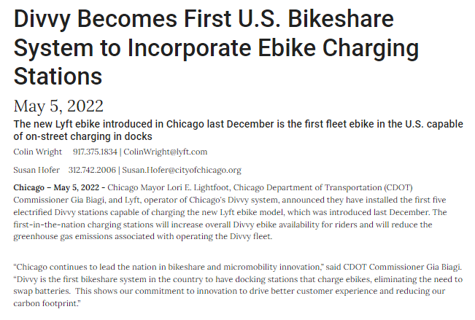

“
The Divvy system will bring Divvy service to all areas of Chicago later this year. In 2021, over 400,000 new riders tried Divvy, and a total of 5.5 million rides were taken, breaking every previous record. Meanwhile, CDOT and Lyft aim to make Divvy affordable for all Chicagoans through low-cost Divvy for Everyone (D4E) memberships for income-qualifying Chicagoans, which currently has over 5,400 members, an all-time high.
”
https://www.chicago.gov/city/en/depts/cdot/provdrs/future_projects_andconcepts/news/2022/may/divvy-becomes-first-u-s--bikeshare-system-to-incorporate-ebike-c.html

Slide 3
Did the introduction of new fleet e-bike result in increased rides and memberships for divvy in 2021-22?
H₀ : E-Bikes are responsible for high revenue and more subscribers
H₁ : E-Bikes are not responsible for high revenue and more subscribers
Hypothesis
To analyse the factors responsible for increase in membership of Chicago Divvy Bikes.
Given membership leads to increase in revenue, we aim to propose a marketing strategy to maximise revenue in the 2023
Objective
Significance of Analysis:
90% of Divvy riders are annual subscribers.
On rough assumptions, Divvy has negative unit economics — it loses money on each bike due to low ridership and its pricing model.
The bulk of its revenue for the city, however, comes from advertising and sponsorships.
250% increase in subscribers will lead to breakeven for Divvy bikes. (Link of article below)
Chicago sees drop in Divvy income following expansion into South, West sides – Chicago Tribune

Slide 4
DATA SOURCE AND PREPROCESSING
Source | Description
Scrapped reviews from TripAdvisor IoS Google Play Store | Reviews and Ratings from all the above sources.
Datasets from January 2020 to May 2022 https://ride.divvybikes.com/system-data | Each trip is anonymized and includes: Trip start day and time Trip end day and time Trip start station Trip end station Rider type (Member, Single Ride, and Day Pass)
The data has been processed to remove trips that are taken by staff as they service and inspect the system; and any trips that were below 60 seconds in length (potentially false starts or users trying to re-dock a bike to ensure it was secure).
Missing Values
Duplicates and Outliers
Start Time > End Time
Irrelevant Rides
Checked for missing values
Checked and found no duplicates
Swapped the values
Removed rides with time period less than 60 seconds

Slide 5
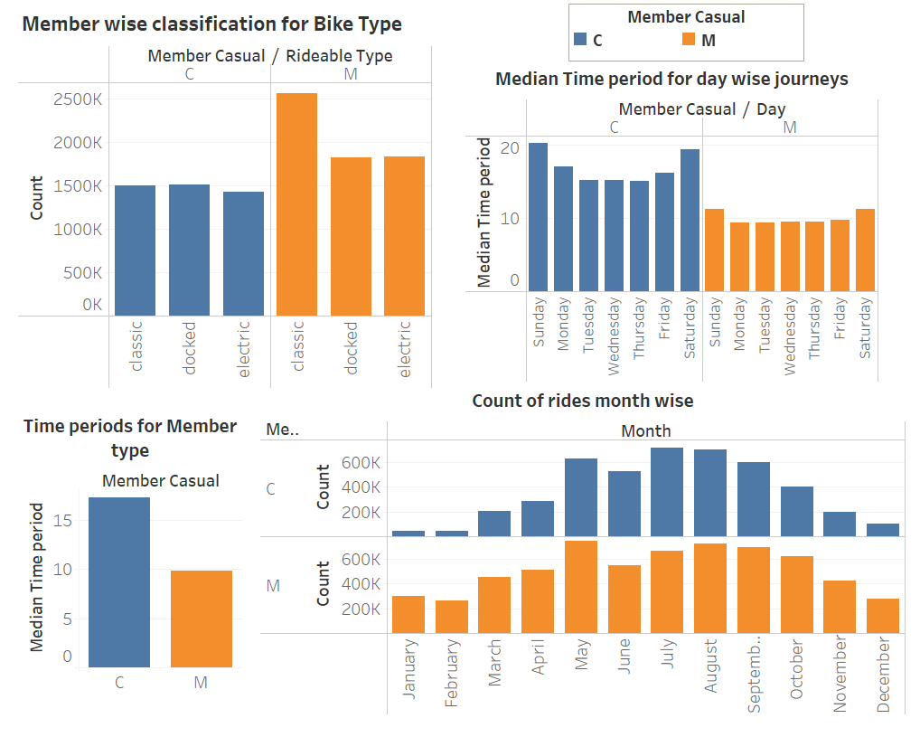
CONSUMER PERSONA
Casual
No bike preference
Rides for Longer Durations
Rides more on Weekends
Rides more from May through September
Member
Prefers Classic Bikes
Rides for Shorter Durations
Rides more on Weekdays
Rides more from May through September

Slide 6
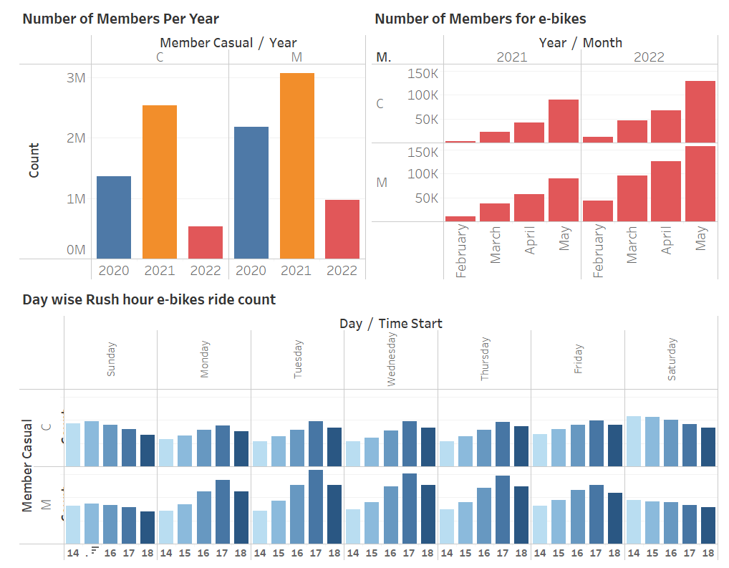
Did usage of e-bikes increase?

Slide 7
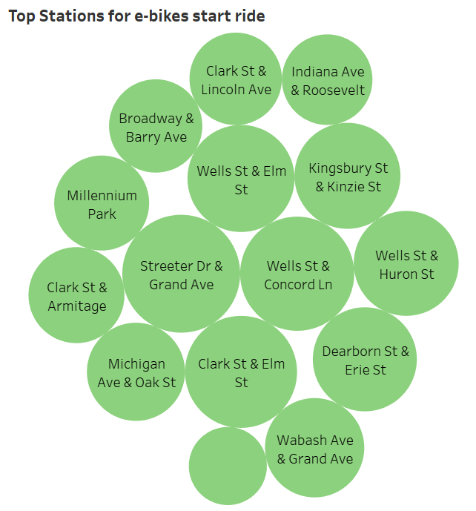
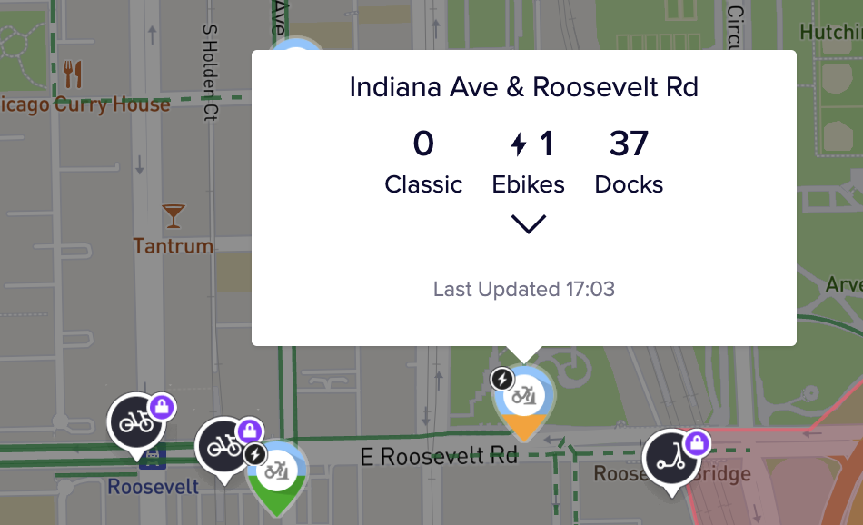
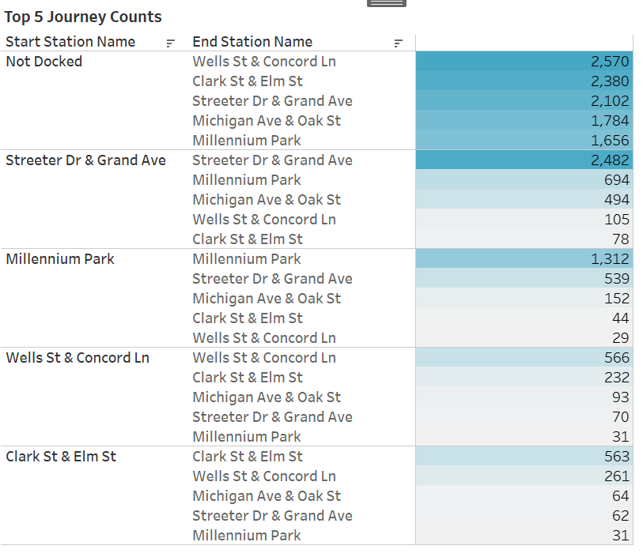
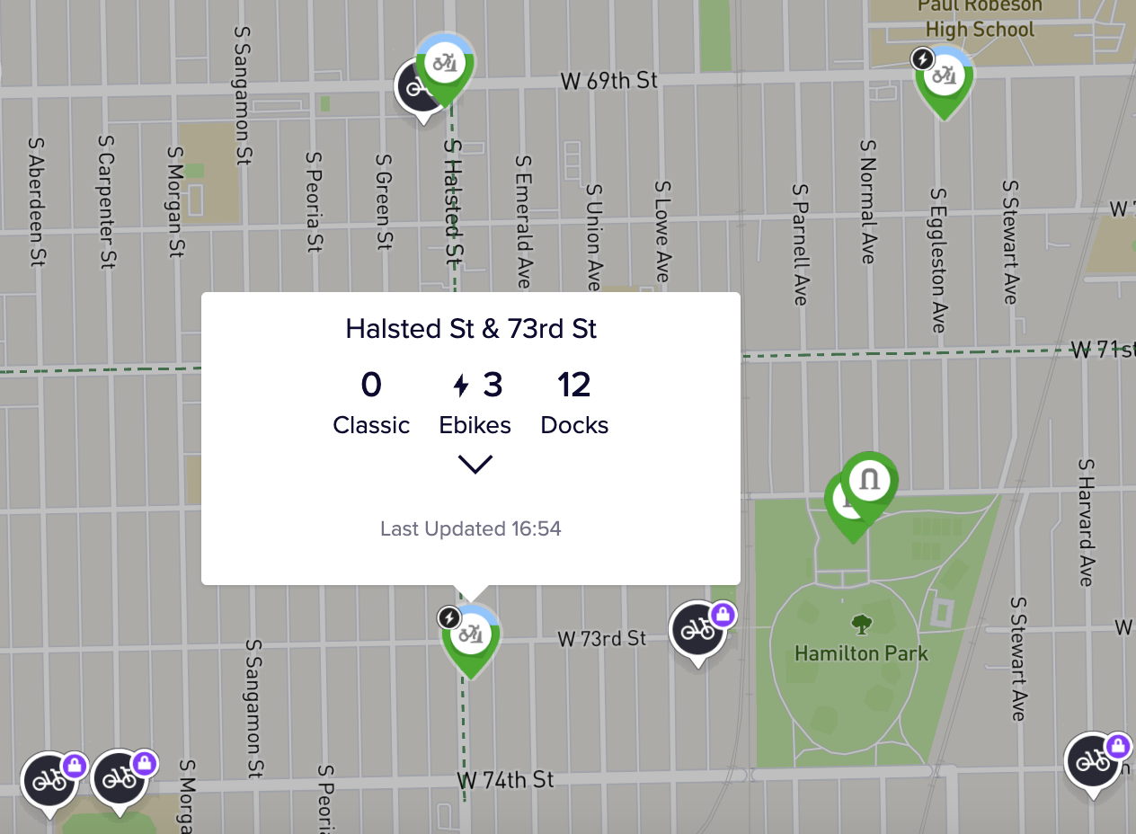
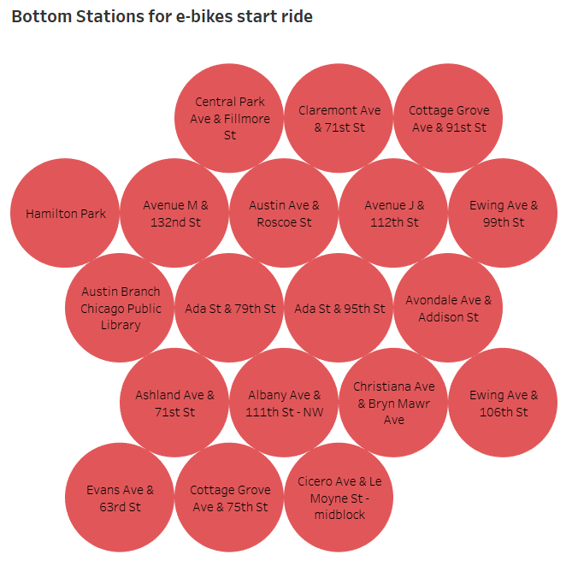
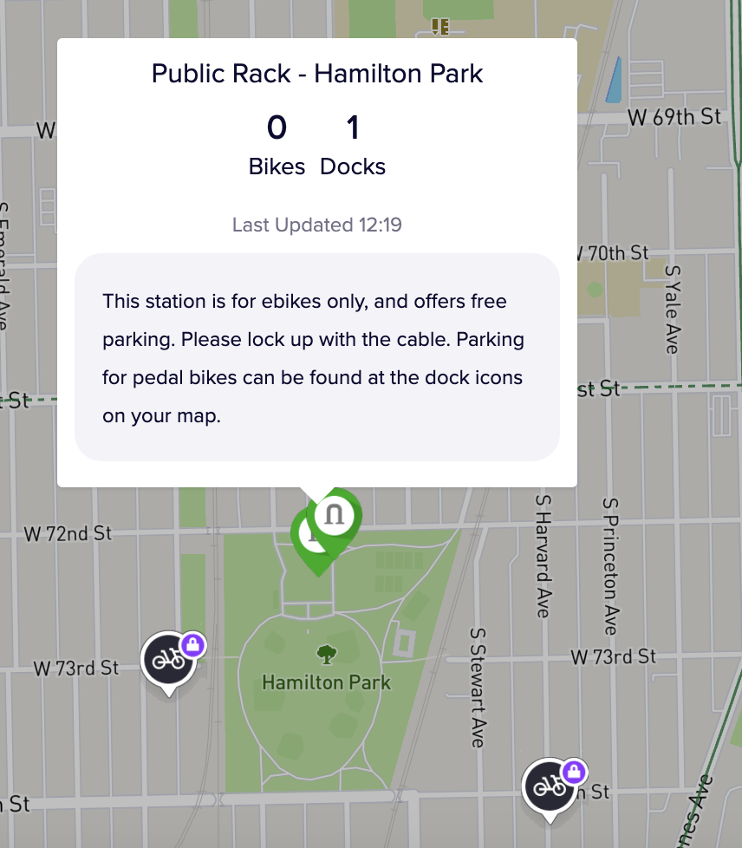
E-bikes easily available?

Slide 8
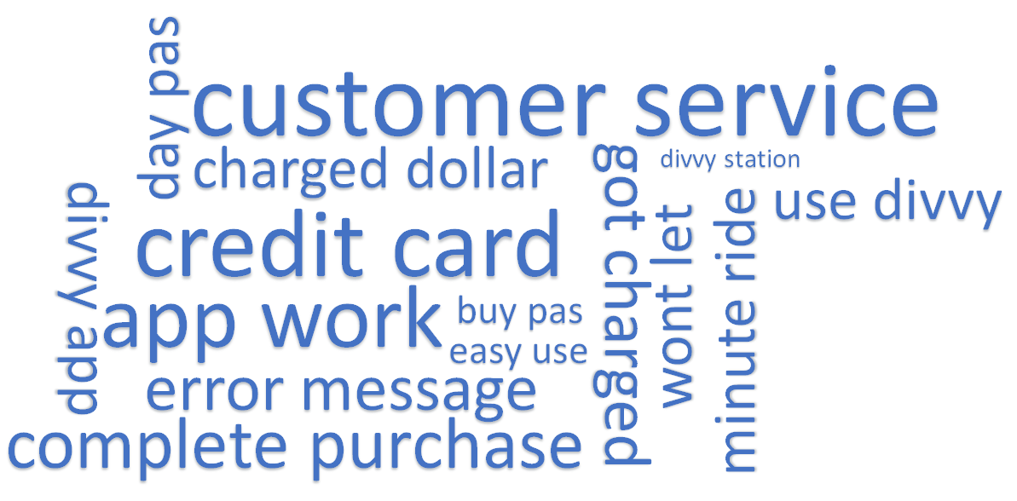
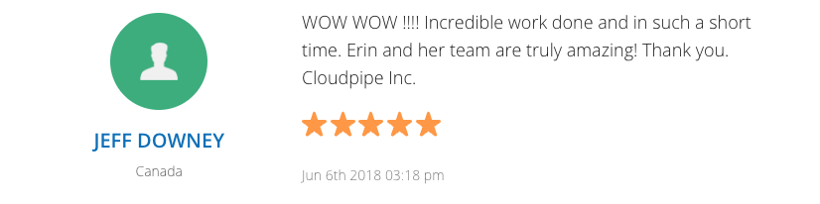
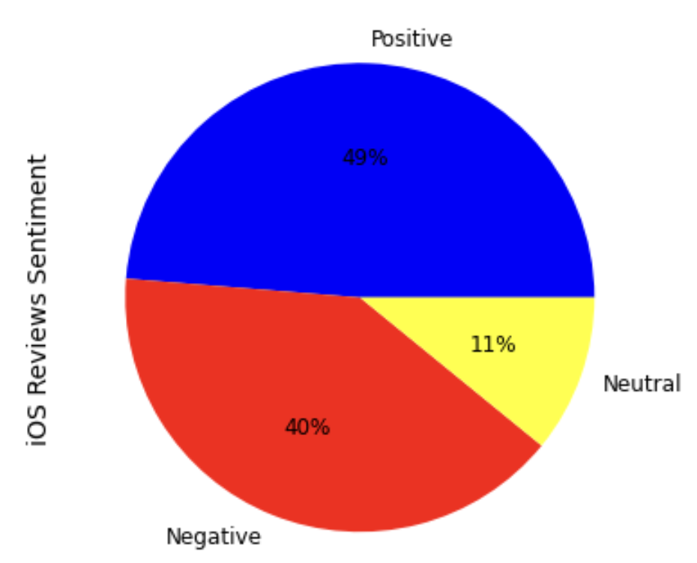
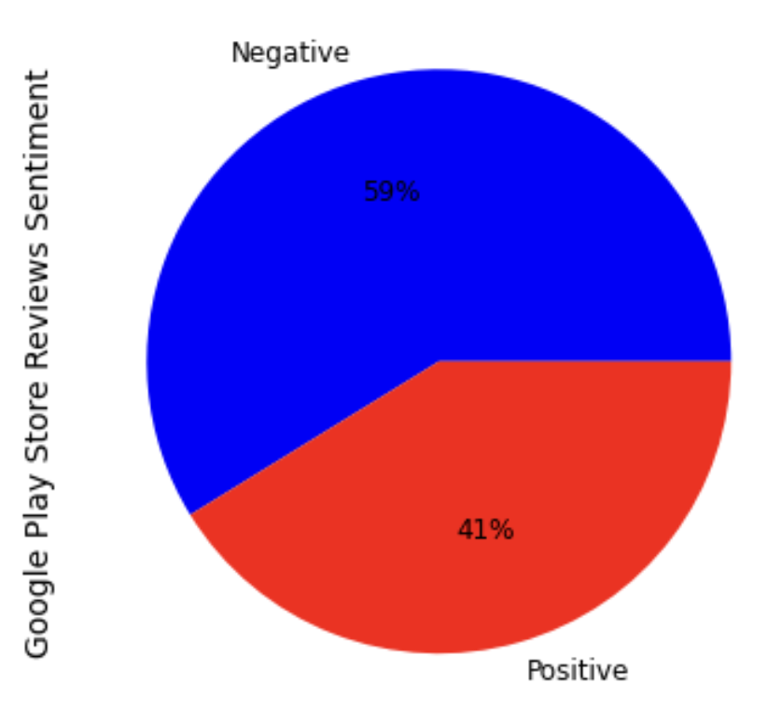
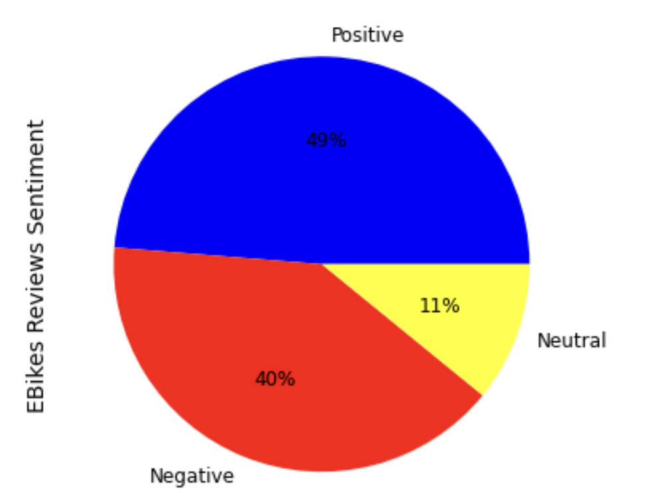
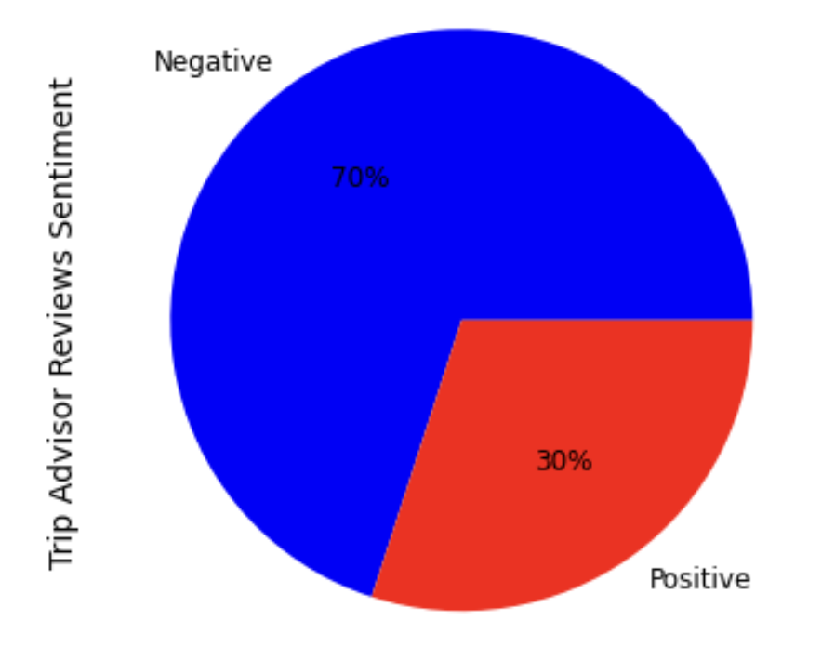
REVIEW ANALYSIS
Keyword Analysis and Top 3 topics from LDA
Sentiment Analysis
Keyword Analysis
credit card minute ride customer service charged dollar
credit card complete purchase wont let buy pas app work
app work customer service use app credit card
Top 3 topics from LDA

Slide 9
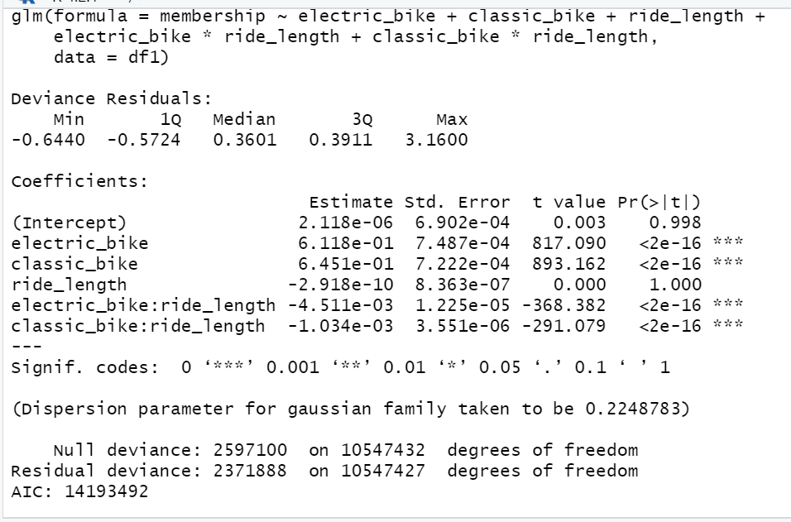
MODELLING -
LOGISTIC REGRESSION
Formulation:
membership = electric_bike + classic_bike + ride_length + electric_bike * ride_length + classic_bike * ride_length + error
Insight:
1 unit increase in electric bikes leads to 1.84 (e^0.6118) times increase in membership.
1 unit increase in classic bikes leads to 1.91 (e^0.6451) times increase in membership.

Slide 10
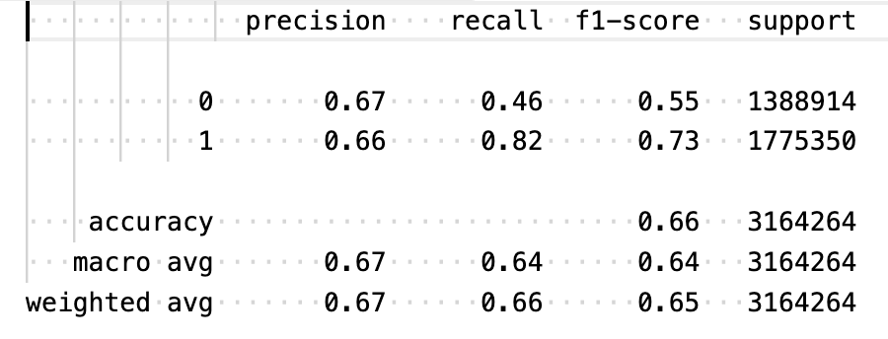
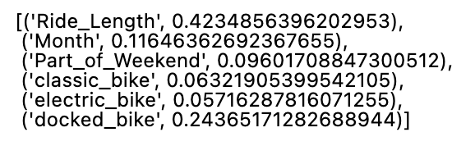
MODELLING -
RANDOM FOREST
Response variable: Member/ Casual
Predictor variable: Ride Length, Month of the year, part of week/ weekend, classic bike, electric bike, docked bike
Insight: The electric is the least important feature as per random forest model attributing to divvy membership

Slide 11



INFERENCES AND RECOMMENDATIONS
Mobile Application needs to be updated to showcase accurate information
Strategies need to be implemented for Classic Bikes as well
The payment methods and ride cost calculations needs more precision

Slide 12
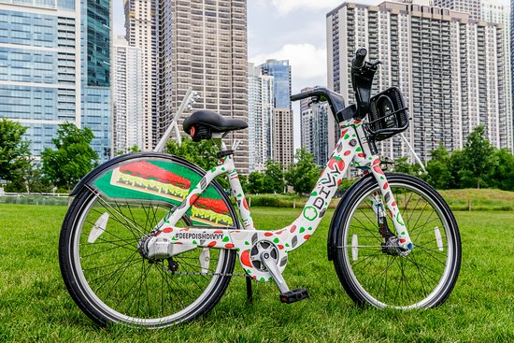




MARKETING STRATEGY
Ride Long
Offer discounts to consumers if they ride for longer durations, provided they are members.
Track It All
Consider Integration with Smart Wearable Mobile Applications
Season Time
Provide memberships on seasonal basis along with day pass, and annual memberships
Show Time
Partner with the fitness centres, food joints and other famous places by displaying their ad on the Divvy Bike

Slide 13
LIMITATIONS
With respect to Insights
If investing in app will increase revenue cannot be proven. A/B testing can be done further.
With respect to Approach
Cannot distinguish how much to invest in electric bike versus the other factors.
Ho: E-Bikes are responsible for high revenue and more subscribers
With respect to Data
No user level information only ride level information is available.
No revenue from rides.

Slide 14
THANK
YOU

